Slide 1
Amazon SageMaker
API, SDK and Security
Christian Petters, Solutions Architect
Friday, July 27, 2018
Notes:
Challenges:
Having ML models doesn’t make an AI company
ML needs to be integrated in infrastructure ecosystem and business processes
ML code is only a small part of an overall ML production system
Old and new challenges for development and support processes
Operational requirements around model governance and auditability

Slide 2
Network security

Slide 3
Amazon Virtual Private Cloud (VPC)
Your own logically isolated section of AWS
Bring your network:
IP Addresses
Subnets
Network Topology
Routing Tables
Multiple Connectivity Options
Advanced Security Features

Slide 4
Amazon VPC
Availability Zone ‘A’
Availability Zone ‘B’
Notes:
Because of main route table, all instances can route to other instances in VPC
Routing tables in a VPC are not for intra-VPC communication, but rather to establish routes outside of the VPC.

Slide 5

Network Building Blocks Network Control – Security Groups
Anything Else
TCP 443
Inbound Security Group SG-Notebooks
Traffic from | Protocol | L4 | Port | Action
10.18.0.0/16 | HTTPS | TCP | 443 | Allow
* | * | * | * | Deny
Amazon SageMaker Jupyter Notebook
Inbound Security Group SG-InferenceEndpoints
Traffic from | Protocol | L4 | Port | Action
SG-Notebooks | HTTPS | TCP | 443 | Allow
SG-Apps | HTTPS | TCP | 443 | Allow
* | * | * | * | Deny
TCP 443
Amazon SageMaker Model Endpoint

Slide 6
Encryption

Slide 7
How are you currently encrypting your data?
Notes:
Use this question as a conversation starter to discuss the value of encryption, why it’s not just for financial services and healthcare, and how AWS not only provides for encryption, but makes it easier.

Slide 8

Encryption
Protecting data in-transit and at-rest.
Encryption In-Transit
Encryption At-Rest
HTTPS
Object
SSL/TLS
Database
VPN / IPSEC
Filesystem
SSH
Disk
Details about encryption can be found in the AWS Whitepaper,
“Securing Data at Rest with Encryption”.
Notes:
This slide is not about teaching what encryption is or the differences between transit and rest. It is about mentioning that not only do we provide our customers the ability to encrypt their data as it sits and flows through and in/out of our environment, but that we provide many services and features that make it easier. You should call out KMS, CloudHSM, VGW, EBS encryption, ELB SSL offloading, RDS Oracle TDE, MSSQL TDE, S3 object encryption, etc.
If the customer is currently not encrypting data (either in transit or at rest), this might be a good place to discuss the differences and emphasis the need to do so under the shared responsibility model.

Slide 9





AWS Key Management Service
Managed service to securely create, control, rotate, and use encryption keys.
Customer Master Key(s)
Data Key 1
Data Key 2
Data Key 3
Data Key 4
Amazon S3 Object
Amazon EBS Volume
Amazon Redshift Cluster
Notes:
AWS Key Management Service (KMS) is a managed service that makes it easy for you to create and control the encryption keys used to encrypt your data, and uses Hardware Security Modules (HSMs) to protect the security of your keys. AWS Key Management Service is integrated with several other AWS services to help you protect your data you store with these services. AWS Key Management Service is also integrated with AWS CloudTrail to provide you with logs of all key usage to help meet your regulatory and compliance needs.
Integrated with AWS SDKs and AWS services:
S3, EBS, AWS Import/Export Snowball, RDS, Redshift, CodeCommit, CloudTrail, EMR, Kinesis Firehose, Elastic Transcoder, SES, WorkSpaces, WorkMail
Centralized control.
Easy and automatic key rotation (KMS keeps track of old keys for decryption)
*New Feature*: Bring your own keys to KMS

Slide 10
Amazon SageMaker encryption
Encryption at rest
Model encryption
Output model artifacts
Volume encryption
Notebook instances
Training instances
Model hosting instances
Encryption in transit
API endpoints secured with SSL

Slide 11
Network security

Slide 12
Amazon Virtual Private Cloud (VPC)
Your own logically isolated section of AWS
Bring your network:
IP Addresses
Subnets
Network Topology
Routing Tables
Multiple Connectivity Options
Advanced Security Features

Slide 13
Amazon VPC
Availability Zone ‘A’
Availability Zone ‘B’
Notes:
Because of main route table, all instances can route to other instances in VPC
Routing tables in a VPC are not for intra-VPC communication, but rather to establish routes outside of the VPC.

Slide 14
Network Building Blocks Network Control – Security Groups
Anything Else
TCP 443
Inbound Security Group SG-Notebooks
Traffic from | Protocol | L4 | Port | Action
10.18.0.0/16 | HTTPS | TCP | 443 | Allow
* | * | * | * | Deny
Amazon SageMaker Jupyter Notebook
Inbound Security Group SG-InferenceEndpoints
Traffic from | Protocol | L4 | Port | Action
SG-Notebooks | HTTPS | TCP | 443 | Allow
SG-Apps | HTTPS | TCP | 443 | Allow
* | * | * | * | Deny
TCP 443
Amazon SageMaker Model Endpoint

Slide 15
Identity and Access Management

Slide 16
What is Identity Management?
“…the management of individual principals, their authentication, authorization, and privileges
…with the goal of increasing security and productivity while decreasing cost, downtime and repetitive tasks.”
(Wikipedia)
Notes:
IAM allows you to implement a comprehensive access control on AWS resources.
IAM is giving you the ability to Authenticate, Authorize, Log all access.
-> Authenticate, including regular credentials or with strong authentication for your privilege users (or everybody), as well authenticate an other AWS accounts or even trust other Identity Providers
-> Authorize with granularity who can do what. Therefore you can implement Least Privilege and Segregation of Duties.
-> And finally, Log every allow and deny in CloudTrail, for troubleshoot or audit purposes.
Basically when you think Access control with AWS resources then think IAM… Every time.

Slide 17



AWS Principals
Account Owner ID (Root Account)
IAM Users, Groups and Roles
Access to all subscribed services.
Access to billing.
Access to console and APIs.
Access to Customer Support.
Temporary Security Credentials
Access to specific services.
Access to console and/or APIs.
Access to Customer Support (Business and Enterprise).
Access to specific services.
Access to console and/or APIs.

Slide 18
AWS IAM Hierarchy of Privileges
Enforce principle of least privilege with Identity and Access Management (IAM) users, groups, and policies and temporary credentials.
Permissions | Example
Unrestricted access to all enabled services and resources. | Action: * Effect: Allow Resource: * (implicit)
Access restricted by Group and User policies | Action: [‘s3:*’,’sts:Get*’] Effect: Allow Resource: *
Access restricted by generating identity and further by policies used to generate token | Action: [ ‘s3:Get*’ ] Effect: Allow Resource: ‘arn:aws:s3:::mybucket/*’
AWS Account Owner (Root)
AWS IAM User
Temporary Security Credentials

Slide 19
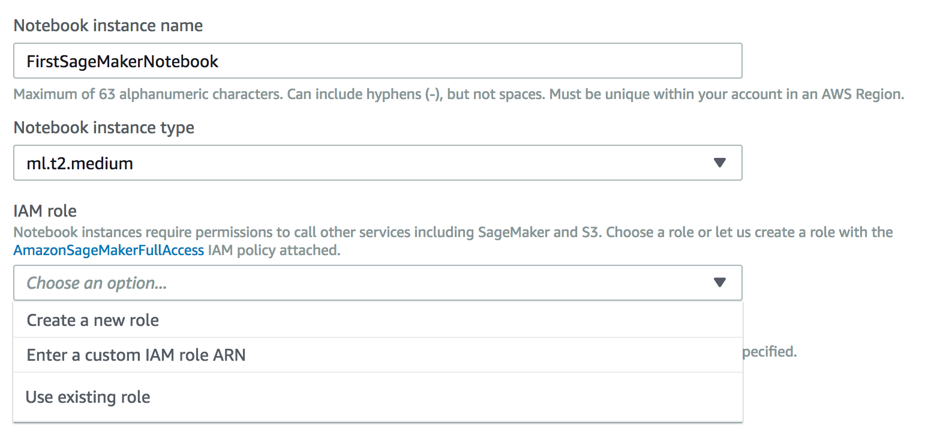
Amazon SageMaker default permissions

Slide 20
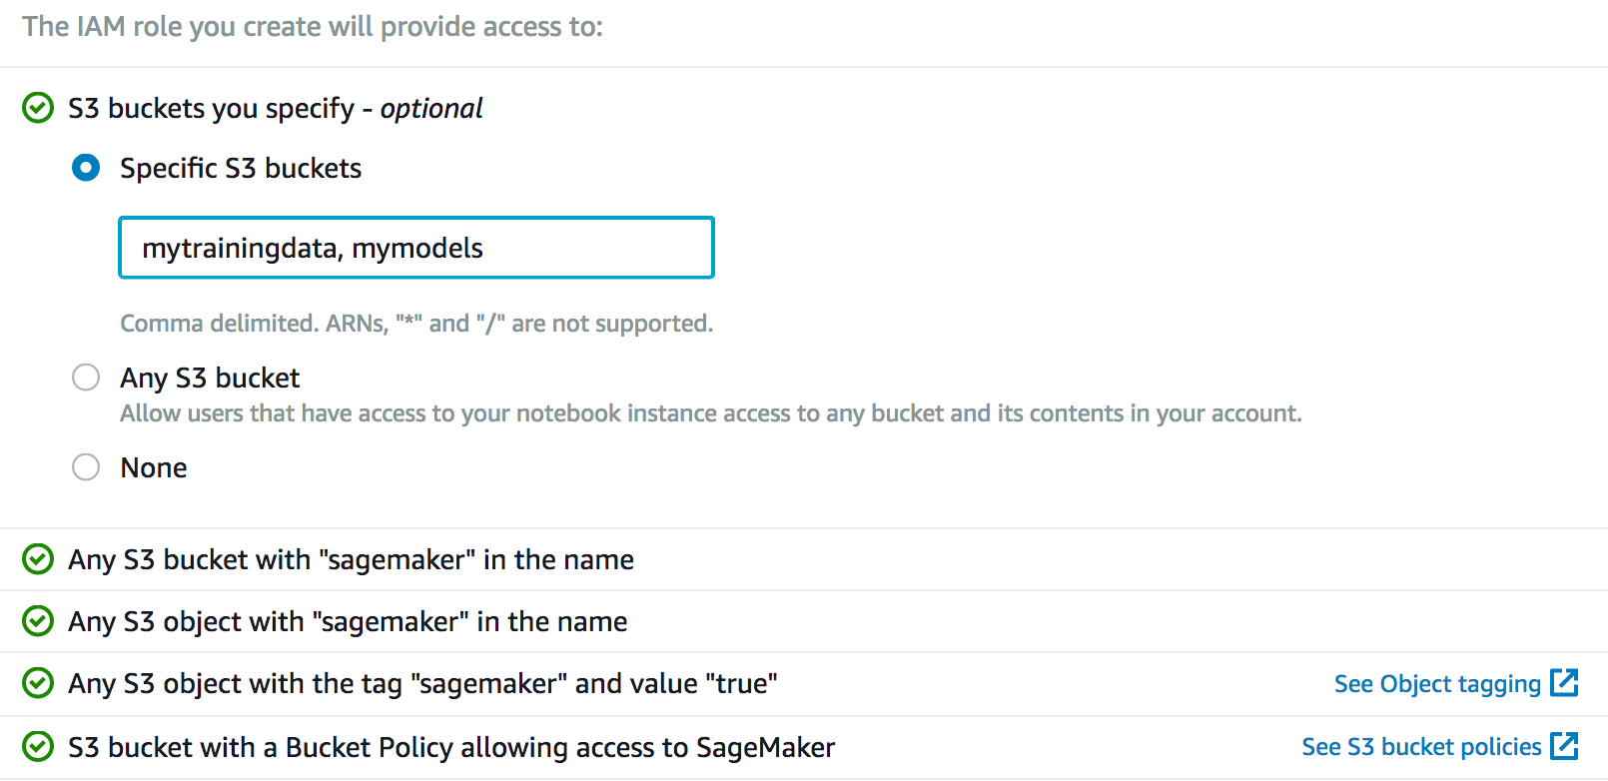
Amazon SageMaker default permissions

Slide 21
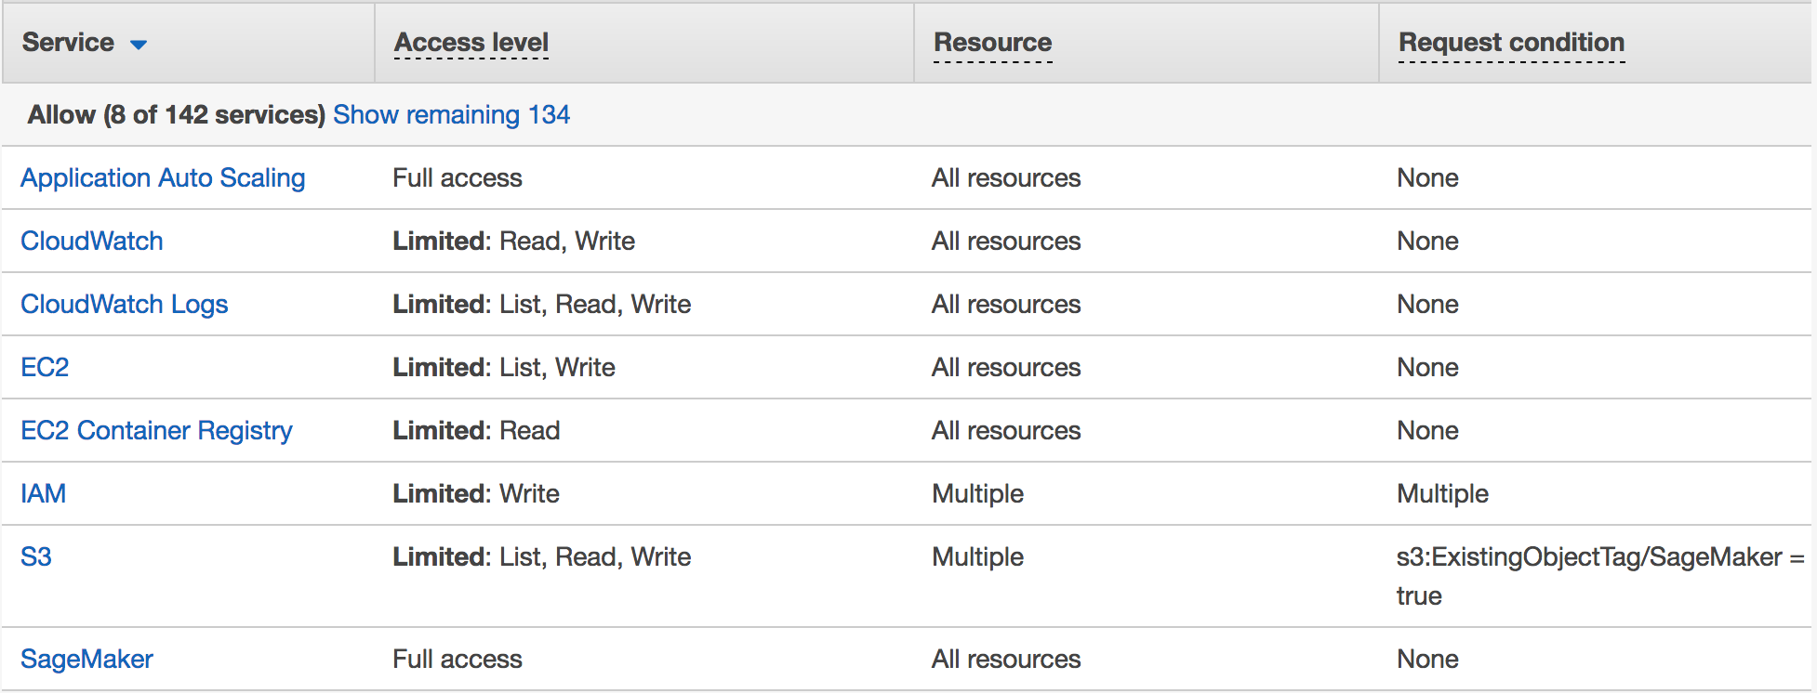
Amazon SageMaker default permissions

Slide 22
Amazon SageMaker optional bucket managed policy
{
"Action": [
"s3:ListBucket"
],
"Effect": "Allow",
"Resource": [
"arn:aws:s3:::mytrainingdata",
"arn:aws:s3:::mymodels"
]
},
{
"Action": [
"s3:GetObject",
"s3:PutObject",
"s3:DeleteObject"
],
"Effect": "Allow",
"Resource": [
"arn:aws:s3:::mytrainingdata/*",
"arn:aws:s3:::mymodels/*"
]
}

Slide 23
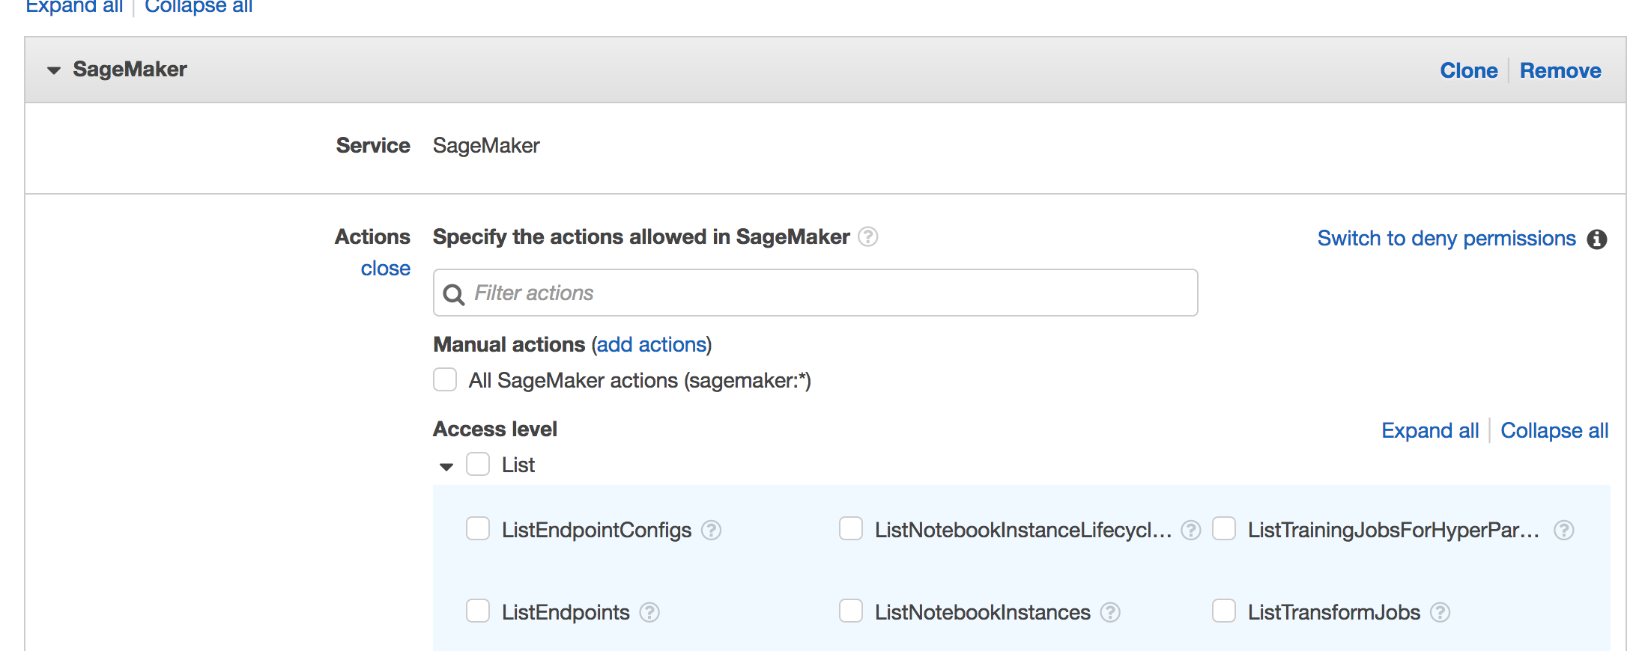
IAM Actions
Full reference:
https://docs.aws.amazon.com/sagemaker/latest/dg/api-permissions-reference.html
Notes:
Open IAM Console to make an example
Open documentation for full reference https://docs.aws.amazon.com/sagemaker/latest/dg/api-permissions-reference.html

Slide 24
Amazon SageMaker API and SDKs

Slide 25
Amazon SageMaker SDKs
AWS Software Development Kit
Supporting multiple Development languages and platforms
SageMaker Service API to automate common tasks
Runtime API for inference requests against hosted models
Boto3 SDK for Python
Amazon SageMaker Libraries
Apache Spark Library
PySpark SDK
Scala SDK
High-level Python library
Estimator and Model encapsulation of SageMaker SDK
Supporting common frameworks like MXNet, Tensorflow, Chainer, etc.
Notes:
Java, .Net, Node.js, PHP, Python, Ruby, JavaScript, Go, C++
https://github.com/aws/sagemaker-spark
https://github.com/cyrusmvahid/sagemaker-demos

Slide 26
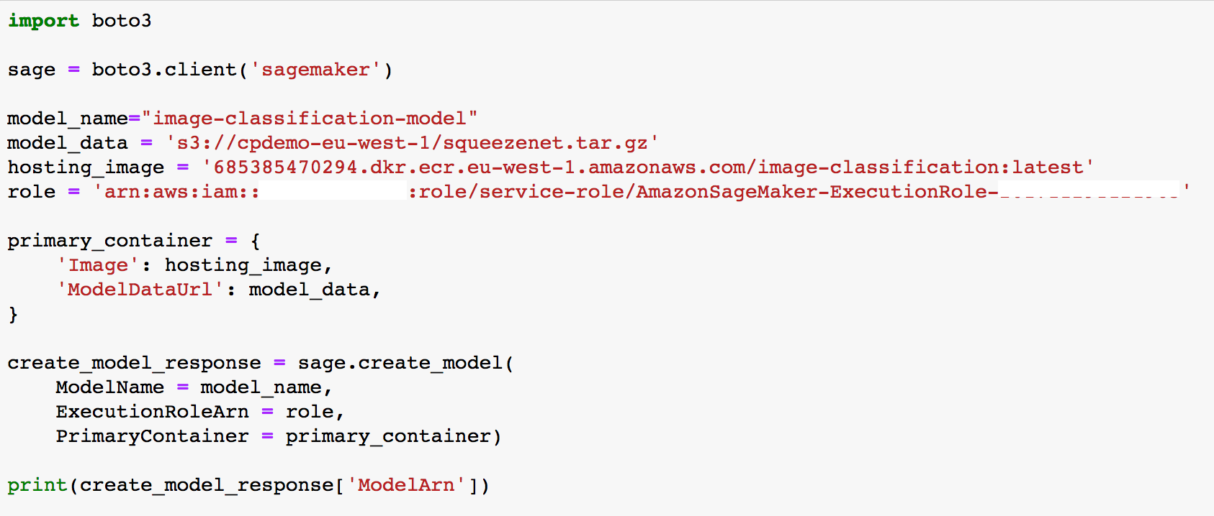
SageMaker Service Boto3 example
Wrong screen shot

Slide 27
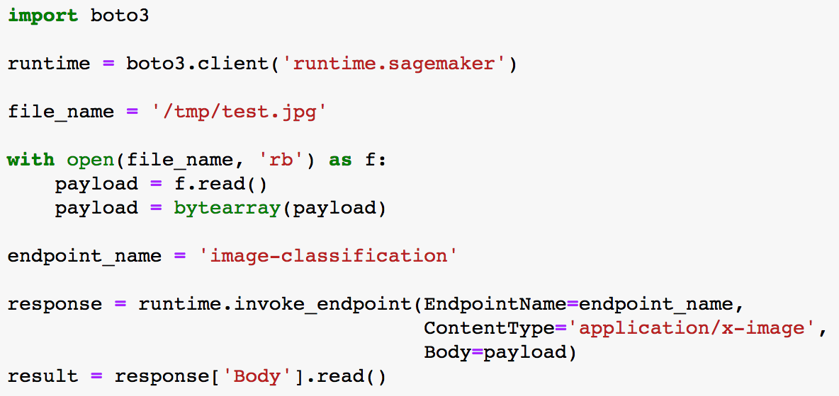
SageMaker Runtime Boto3 example

Slide 28
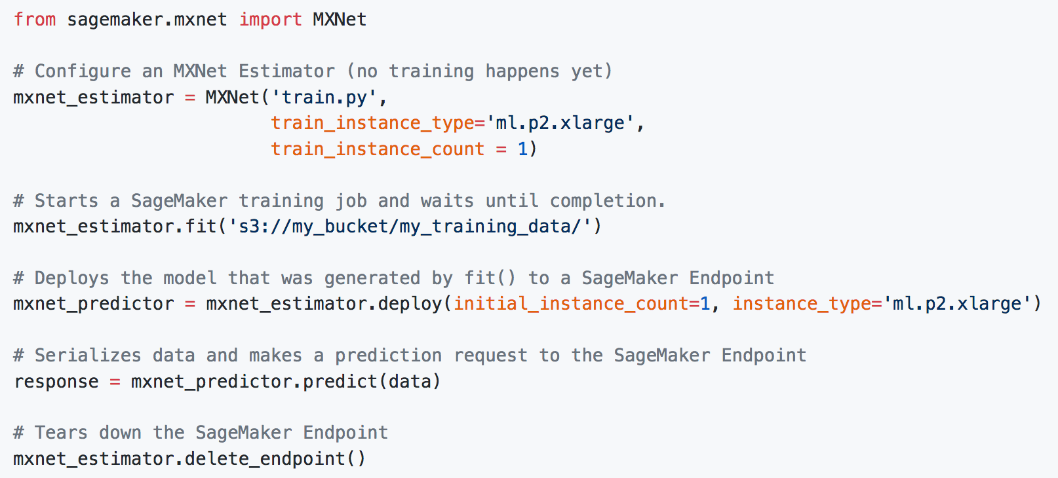
SageMaker MXNet Estimator example

